Slide 1
Trends in New Car Values Through Covid/ Inflation
Question: Could the covid pandemic in 2020 have affected inflation in vehicle prices?

Slide 2
Covid and Inflation
Project Team (Group 5):
Armando Magallan Jr, Lorena Olalde Rios, Roel Jr De Los Santos, and David Rojas.
Project Scope:
As a group we gathered data that would give us a better understanding of the prices of new cars
throughout the years; specifically 2019-2023 to get a view of the prices before the Covid and therefore the
prices afterwards.
Hypothesis: There was a significant increase in average new vehicle CPI from 2019 (before covid) to 2023 (after covid).
Null-Hypothesis: There is no significant change in average new vehicle CPI from 2019 to 2023..
Attributes to Analyzed:
New car volume
New car inflation
New car compounded inflation
Brand/ manufacture trends

Slide 3
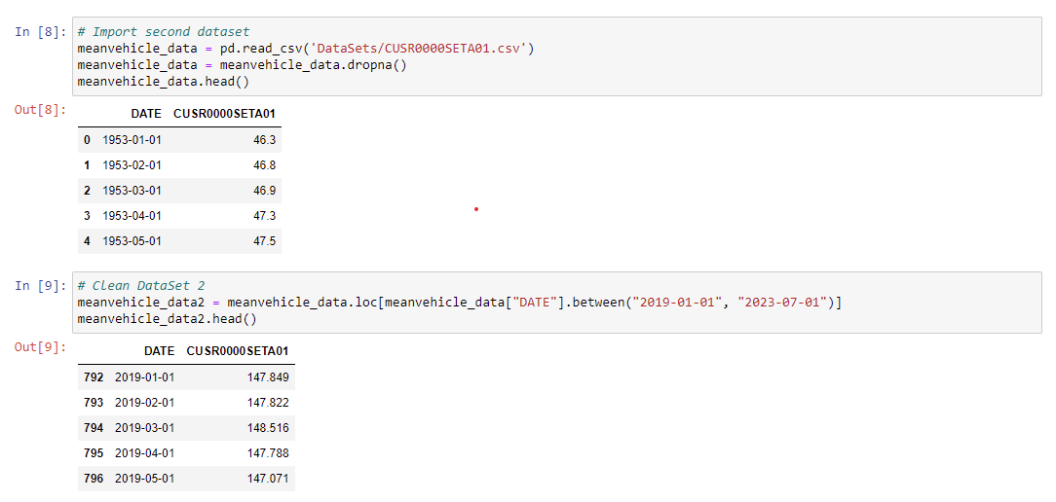
Cleaning the Datasets in Jupyter Notebook
First we imported the CSV files, and then after reading them in, used .loc to narrow down the years we wanted to analyze

Slide 4
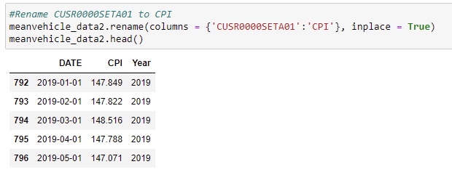
Cleaning Data cont.
Next we created a column for year from the full date in the CSV, and renamed the “CUSR0000SETA01” column to “CPI” to help make things easier to read

Slide 5
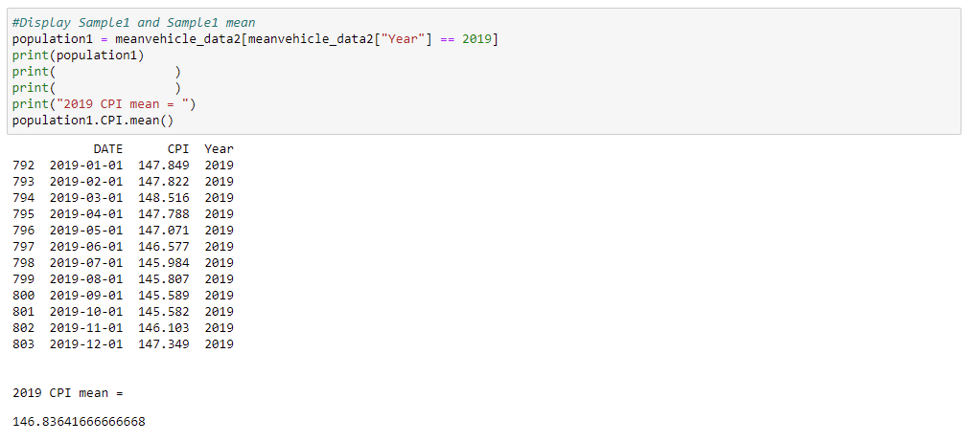
Cleaning Data cont.
Following this, we formatted and displayed our samples used in conducting of the t-test, as well as the mean

Slide 6
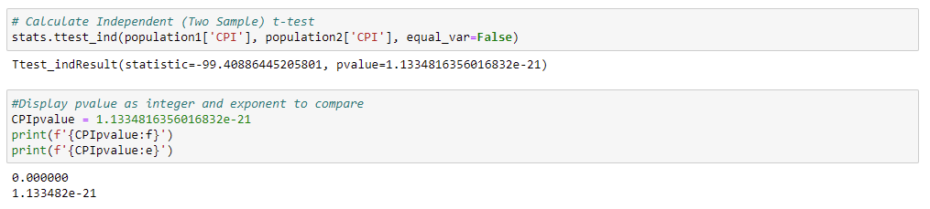
Final cleaning data
After performing the t-test, we displayed and formatted our exponential value to confirm it was multiple decimal places to the right of 0 and thus a very small number

Slide 7
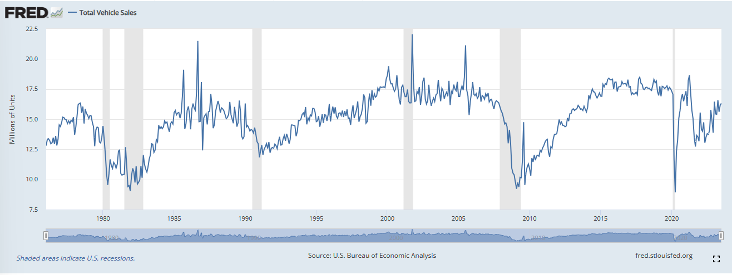
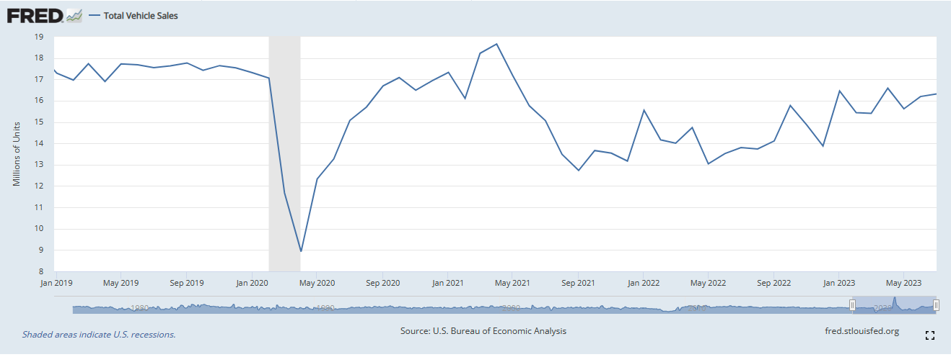
Data Set #1 Total Vehicles Sold (Millions of Units, Seasonally Adjusted Annual Rate)
The 2nd quarter (Q2) of 2019 through the end of that year averaged 17 million vehicles sold in the United States.
Before a big dip in volume during the 1st quarter (Q1) of 2020.

Slide 8
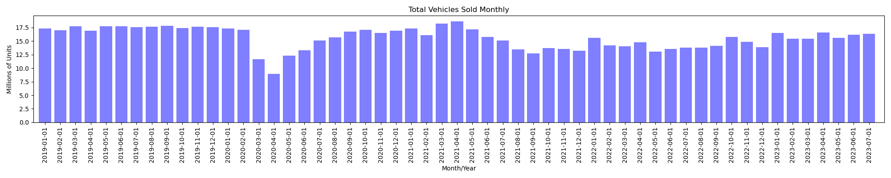
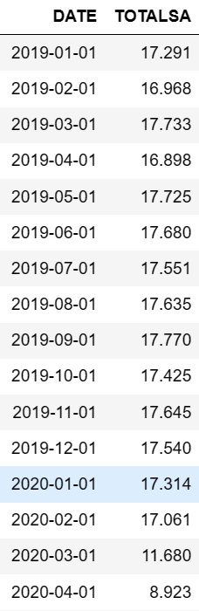
A Market Affected by Covid
As Covid started affecting most markets around the world, the U.S. had a substantial decrease in volume sales.
Q1 2019 started with around 17 million vehicles sold and Q2 2020 ended with around 8 million vehicles sold.
This decrease in volume sold exemplifies the subsequent demand once vehicle production had come to a halt.

Slide 9
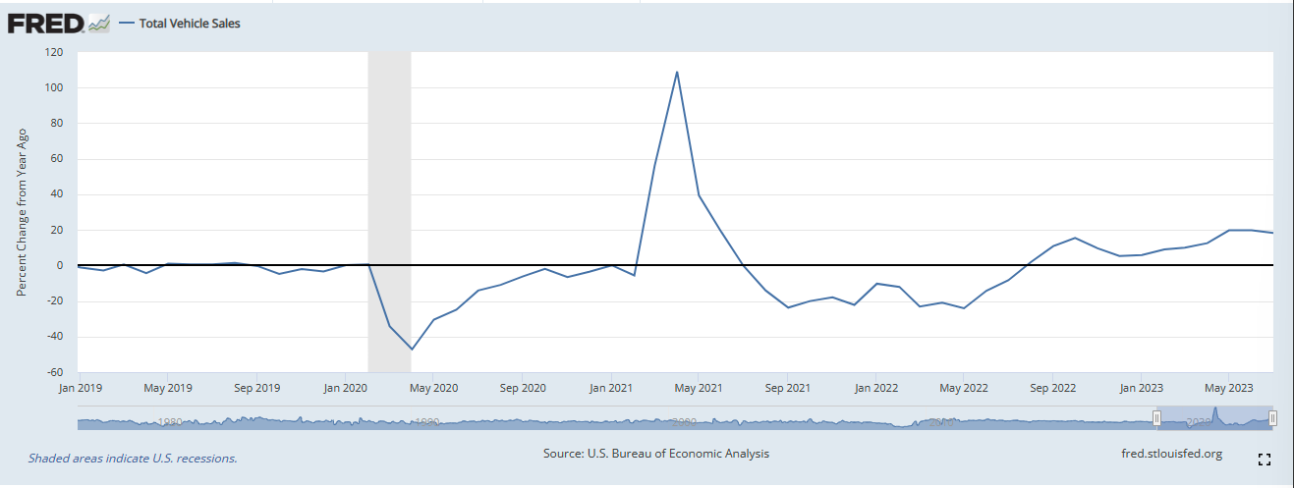
Data Set #1 Total Vehicles Sold (Percent Change from Previous Year)
The Percentage Change from Previous Year (2019) also shows a substantial dip in the rate at which cars were selling during 2020 as compared to 2019.
A percent change of over 47% less from the beginning Q1/2019 to Q2/2020.

Slide 10
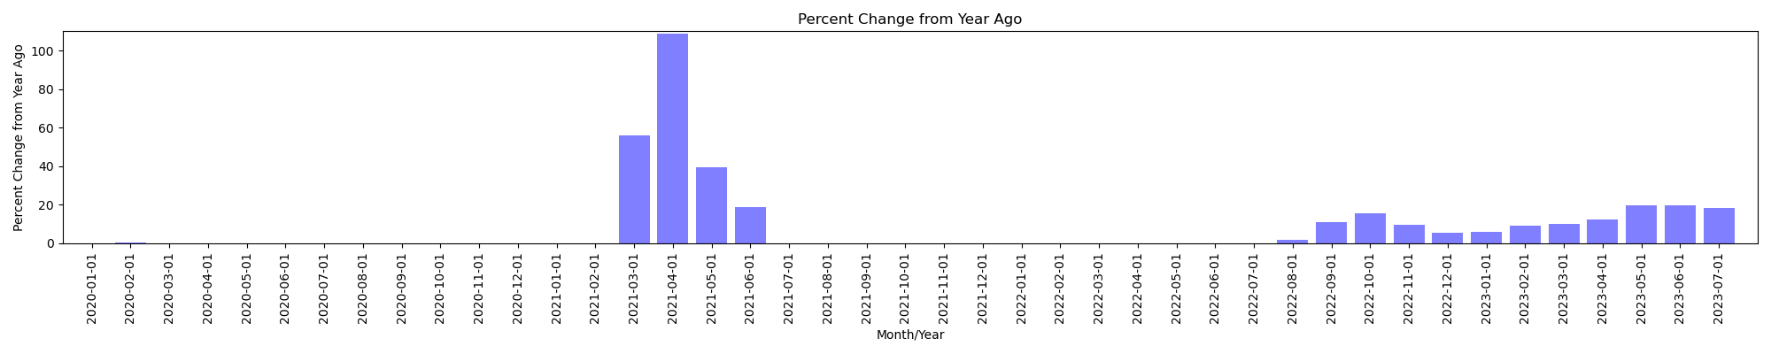
Covid Market Vs. Previous Year
Covid was the cause of the 47% decrease in volume sales once the market shut down and vehicles were not selling.
Once manufacturers stopped producing vehicles, demand and supply were subject to a inflated market after 2020.
Therefore, Q2 2021 shows a peak for demand with 109% change as compared to 2020.

Slide 11
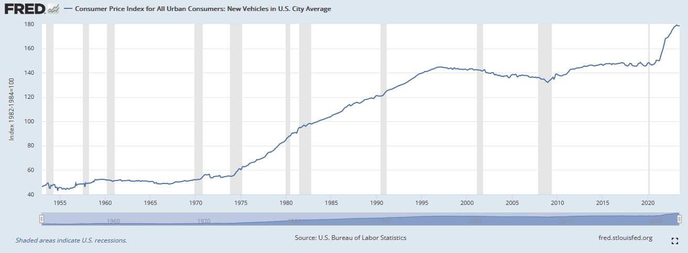
Data Set #2: Cost Price Index(CPI) for New Vehicles by Month
CPI measures the monthly change in prices paid by U.S. consumers
CPI is based off the standard of 100 set in 1984, when the number goes above 100, there is inflation in the market, when the number goes below 100 there is deflation
Data found and sourced from Federal Reserve Economic Data at https://fred.stlouisfed.org/
Question: Could the covid pandemic in 2020 have affected inflation in US New Vehicle CPI?

Slide 12
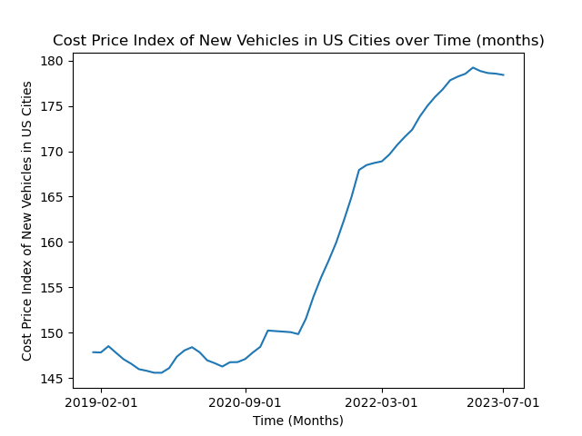
An Already Inflated Market
This dataset shows an already inflated new car market in the US for January 2019 at 147(47%), and continues to inflate above 175 (75%+) by July 2023
This data graph shows a large spike in inflation that occurs after October 2020 and continues through July 2023
Our hypothesis for this data is that there was a significant increase in average new vehicle CPI from 2019 (before covid) to 2023 (after covid)
The null hypothesis would be that there is no significant change in average new vehicle CPI from 2019 to 2023

Slide 13
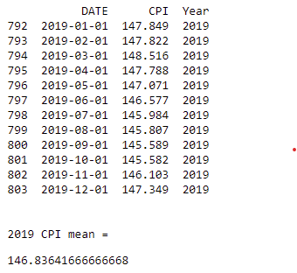
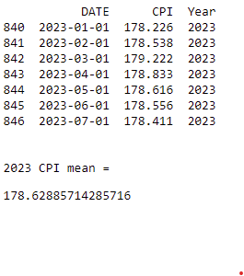
CPI Samples before and after covid pandemic
Sample 1
Sample 2

Slide 14
Testing our hypothesis with an Independent sample T-test
We used an independent T-test to compare samples since we are comparing 2 separate data sets
Our findings show a calculated pvalue of ~1.1334816356016832e-21
Because our pvalue was much smaller than .001, we can conclude that there is very significant evidence against the null hypothesis and thus reject it in favor of the alternate hypothesis
Conclusion: There was a significant increase in average new vehicle CPI from 2019 (before covid) to 2023 (after covid)

Slide 15
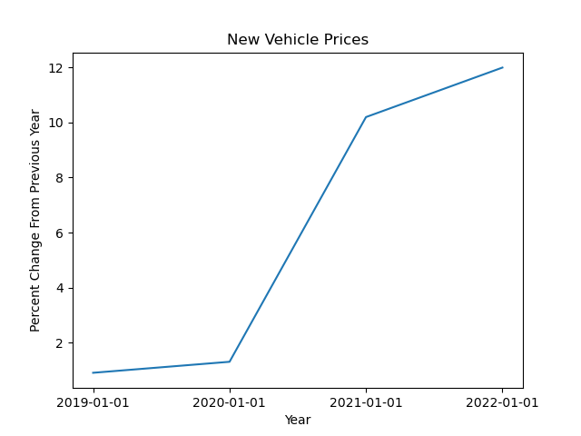
Percent Changes in New Car Prices
Question: Did the percentage in prices of new cars drastically increase between the years 2019 and 2023?
The percentage increase of the prices in cars before 2020; as is shown in 2019; was relatively low but it skyrocketed after 2020.

Slide 16
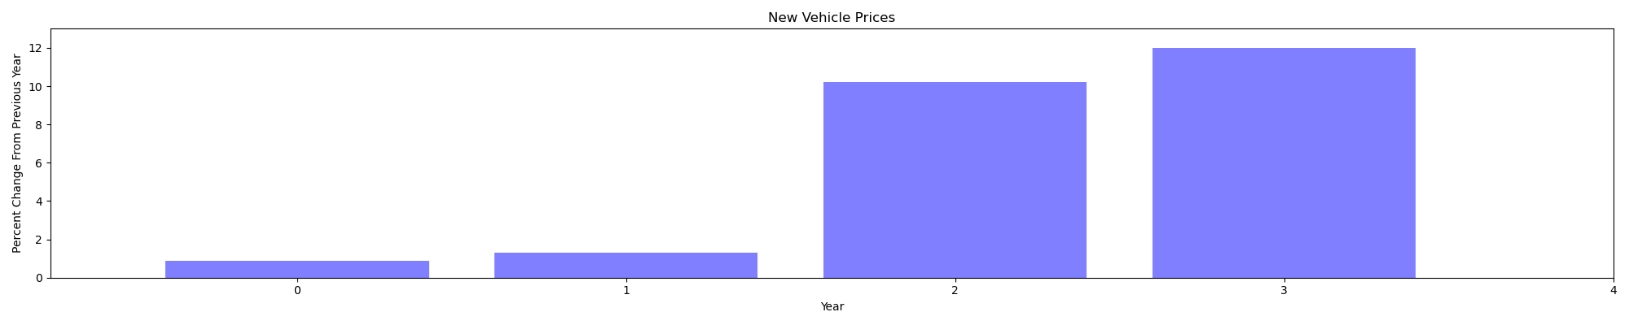
Percent Changes in New Car Prices
The huge increase in the percentage in new car prices can be easily seen in this bar graph the percentage more than triple over the last few years.

Slide 17
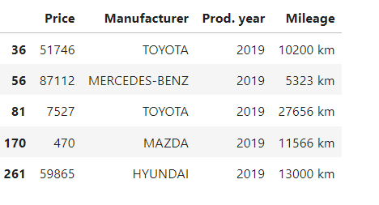
Data set #4 Brand/Manufactures
The cleaned dataset is a curated subset of the original, focusing on vehicles made from 2019 to 2023. This targeted time frame allows us to explore trends in this recent period, revealing insights into technology, design, and manufacturing advancements. It's a valuable resource for analyzing the changing automotive landscape, uncovering manufacturer strategies, market trends, and even vehicle features. This dataset offers a lens into the modern automotive market, providing analysts and researchers with the tools to uncover patterns and deepen their understanding of the industry

Slide 18
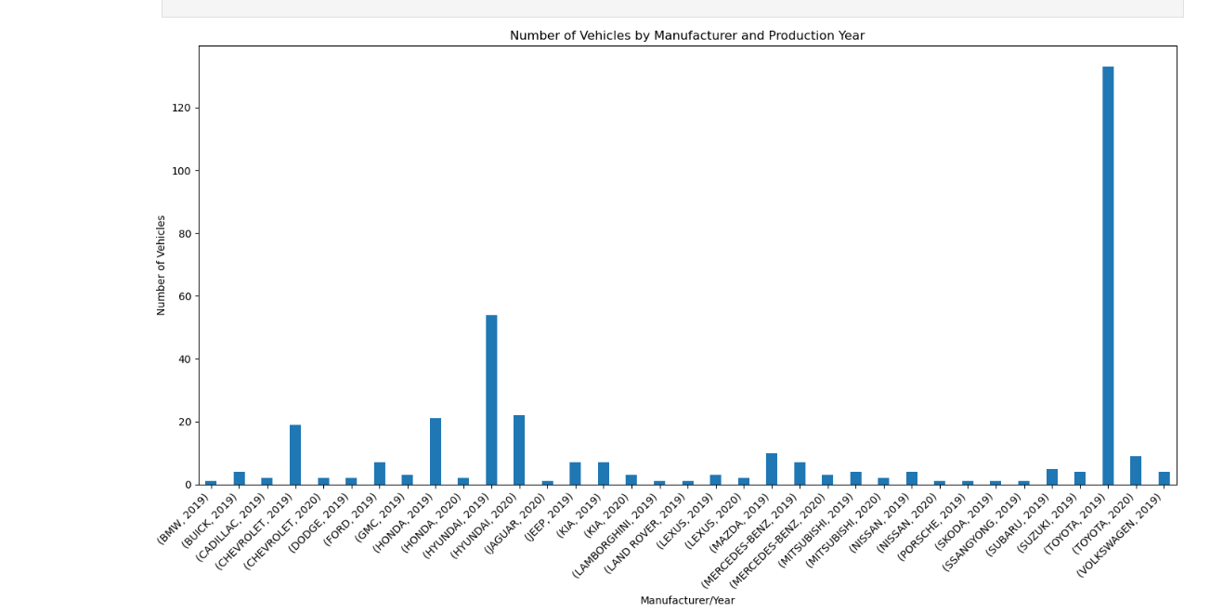
Data set #4 graph Brand/Manufactures
The bar graph visualizes how vehicle production is distributed among different manufacturers during each production year within the specified time range. The x-axis labels provide insights into manufacturers and their respective production years, while the bar heights indicate the number of vehicles produced. This graph is instrumental in revealing trends and patterns in vehicle production across various manufacturers during these years.
Among the manufacturer lineup, Toyota stands out prominently as one of the major players. Its name is prominently displayed on the graph, signifying its significant presence. Toyota's consistent production levels from 2019 to 2023 resonate like a rhythmic beat, underscoring their robust and continuous vehicle manufacturing efforts.

Slide 19
Conclusion
Covid definitely had an impact on vehicles prices and the inflation that ran through the market.
Especially for Toyota as a brand and manufacturer.
Demand and supply have been polar opposites since Q1 2020 and peaking during Q2 2021.
Our findings show a calculated P Value of ~1.1334816356016832e-21.
Because our P Value was much smaller than .001, we can conclude that there is very significant evidence against the null hypothesis and thus reject it in favor of the alternate hypothesis.

